Slide 1

Clock
21107036 : Aman Dhumal
21107053:Om D Jondhale
211070 :Prathamesh Babar
211070 : Rahul Gangurde
Prof. Poonam Pangarkar

Slide 2
Contents
Introduction
Objectives
Features
Built in functions used
Block Diagram
Output Screenshots

Slide 3
1. Introduction
clock, a c program to display time with a graphical interface.

Slide 4
2. Objectives
Write objectives of selected project topic in numbers like
To display Time .

Slide 5
4. Feature
1. will display time in a graphical interface .
2. displays an analog clock.

Slide 6
3. Built in functions used ;
Write about built in functions used from graphics.h file in numbers like
circle(int 1,int 2,outr);
setfillstyle(SOLID_FILL,WHITE);
fillellipse(int 1,int 2);
line(int 1,int 2,int 3,int 4);

Slide 7
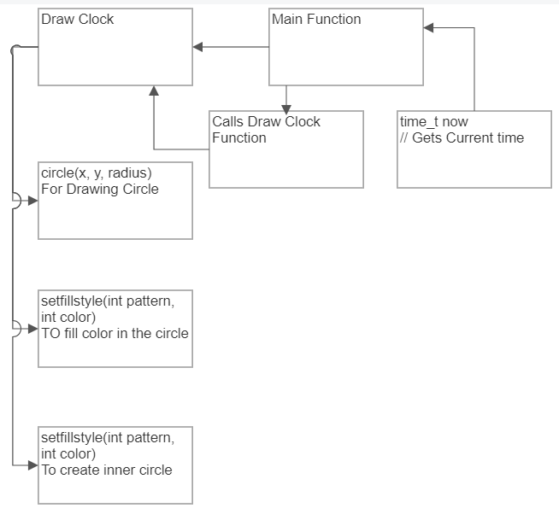
6. Block Diagram
Profile

Slide 8

5. Output of Project
Add screenshots of output window

Slide 9
Thank You...!!

